Slide 1
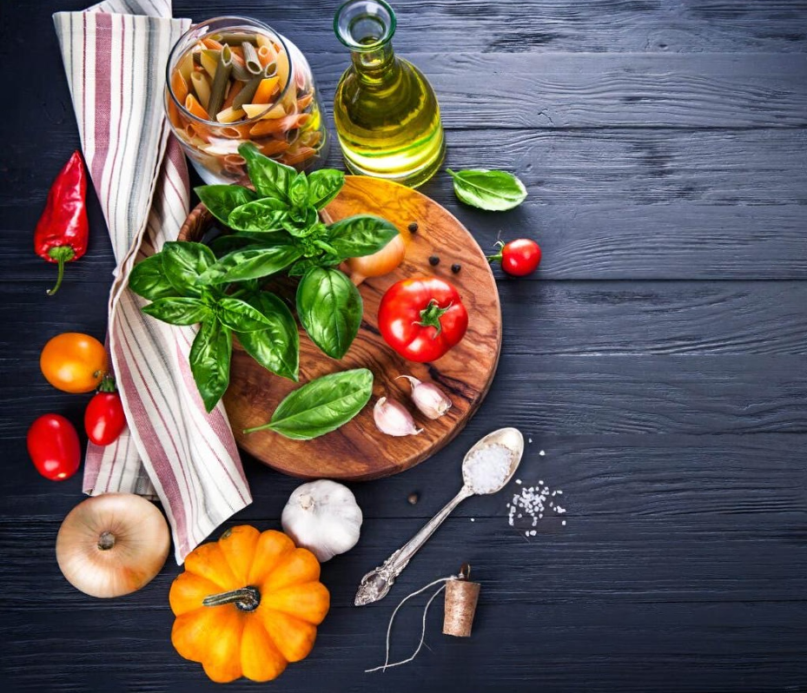
Smart Recipe Generator
“ Turn Ingredients into Delicious Recipes Instantly ”
Mentor: Sri Lalitha Mam
Coordinator: Uday Kumar

Slide 2

Introduction
Quick, healthy meal creation
Personalized meal recommendations
Saves time, reduces waste
Ideal for busy individuals

Slide 3
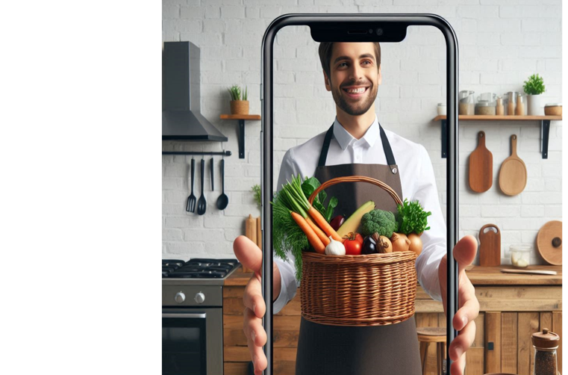
Problem Statement
Meal decision challenges
Limited tailored suggestions
Difficulty meeting nutrition goals
Demand for smart solutions

Slide 4
Solution Overview
AI-Driven Ingredient Recognition
Pre-trained Model for detecting uploaded images.
OCR tools for labeled Ingredients.
Image Processing techniques for better accuracy.
Personalized Recipe Generation
Database-driven recipe matching
Customized recipe suggestions
GPT-3.5 for personalization
Recipe storage for convenience

Slide 5
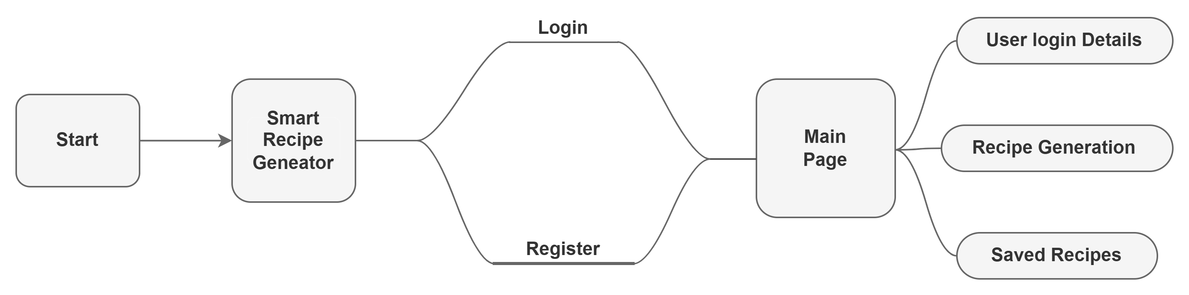
Workflow Diagram
Project Workflow:

Slide 6

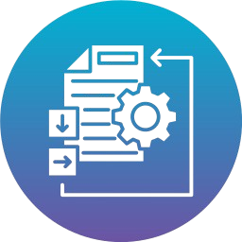




Tech Stack Breakdown
Python
Programming Language
Image processing
OpenCv, Tessearact & pillow (PIL)
Open AI
GPT 3.5 turbo
ML & NLP
Pytorch & Tensorflow
Databases
PostgreSQL & sqlAIchemy
Web/UI Dev
Streamlit

Slide 7
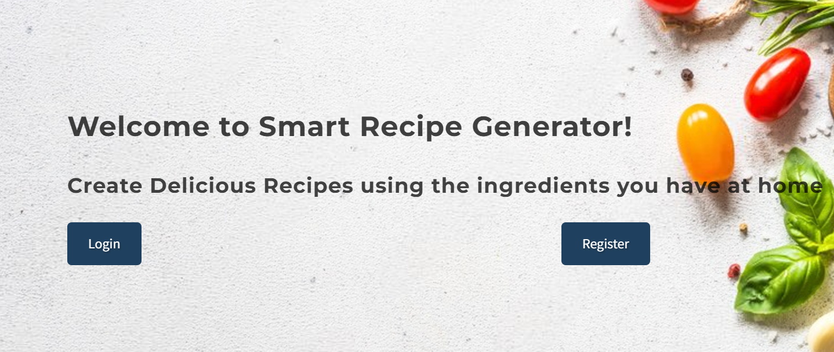
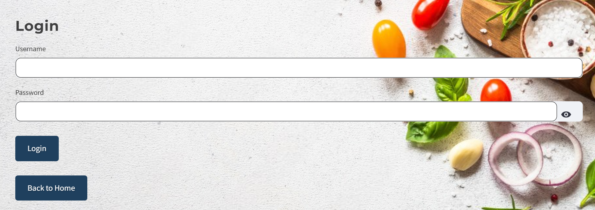
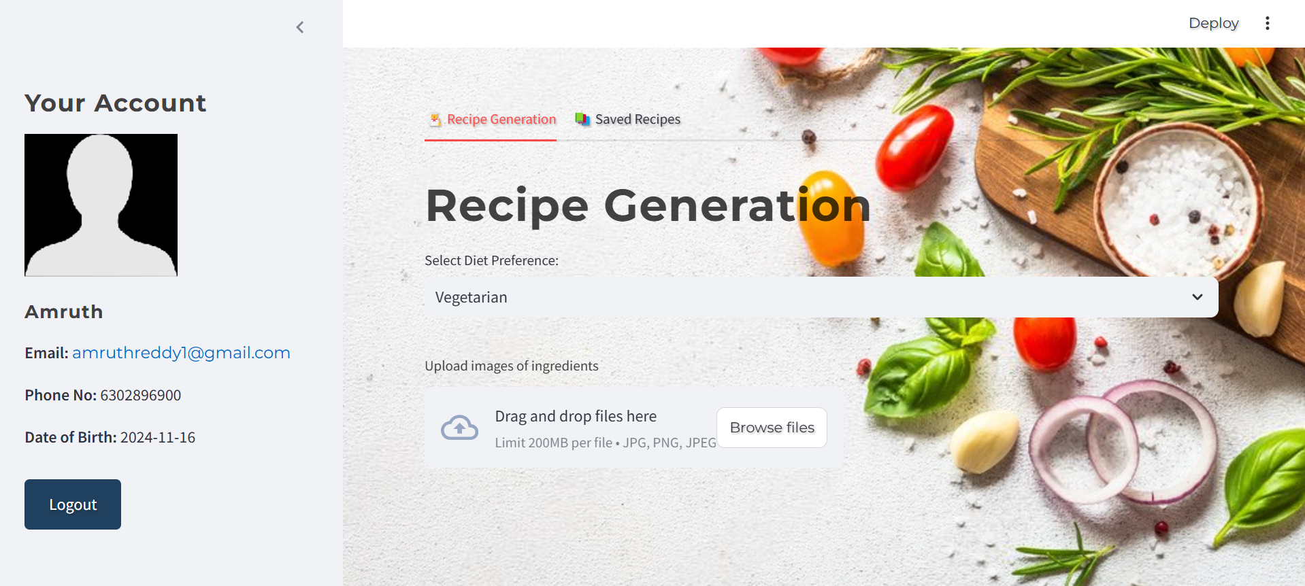
Key Features and Results
Key Features: ​
Recipe Generation​
Food Category Selection​
Generate Another Recipe​
Save Recipe Option​
Saved Recipes Section
Results:

Slide 8
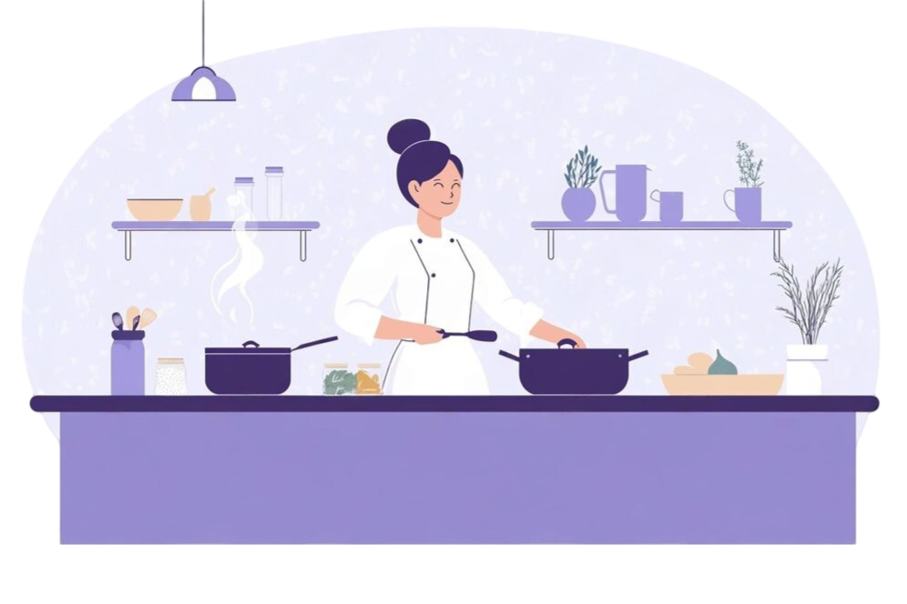
Future Scope
Improve ingredient recognition.
Health-based, allergy-sensitive recipes.
Smart device integration for cooking.
Provide seasonal recipe suggestions.
Integrate with voice assistants.

Slide 9
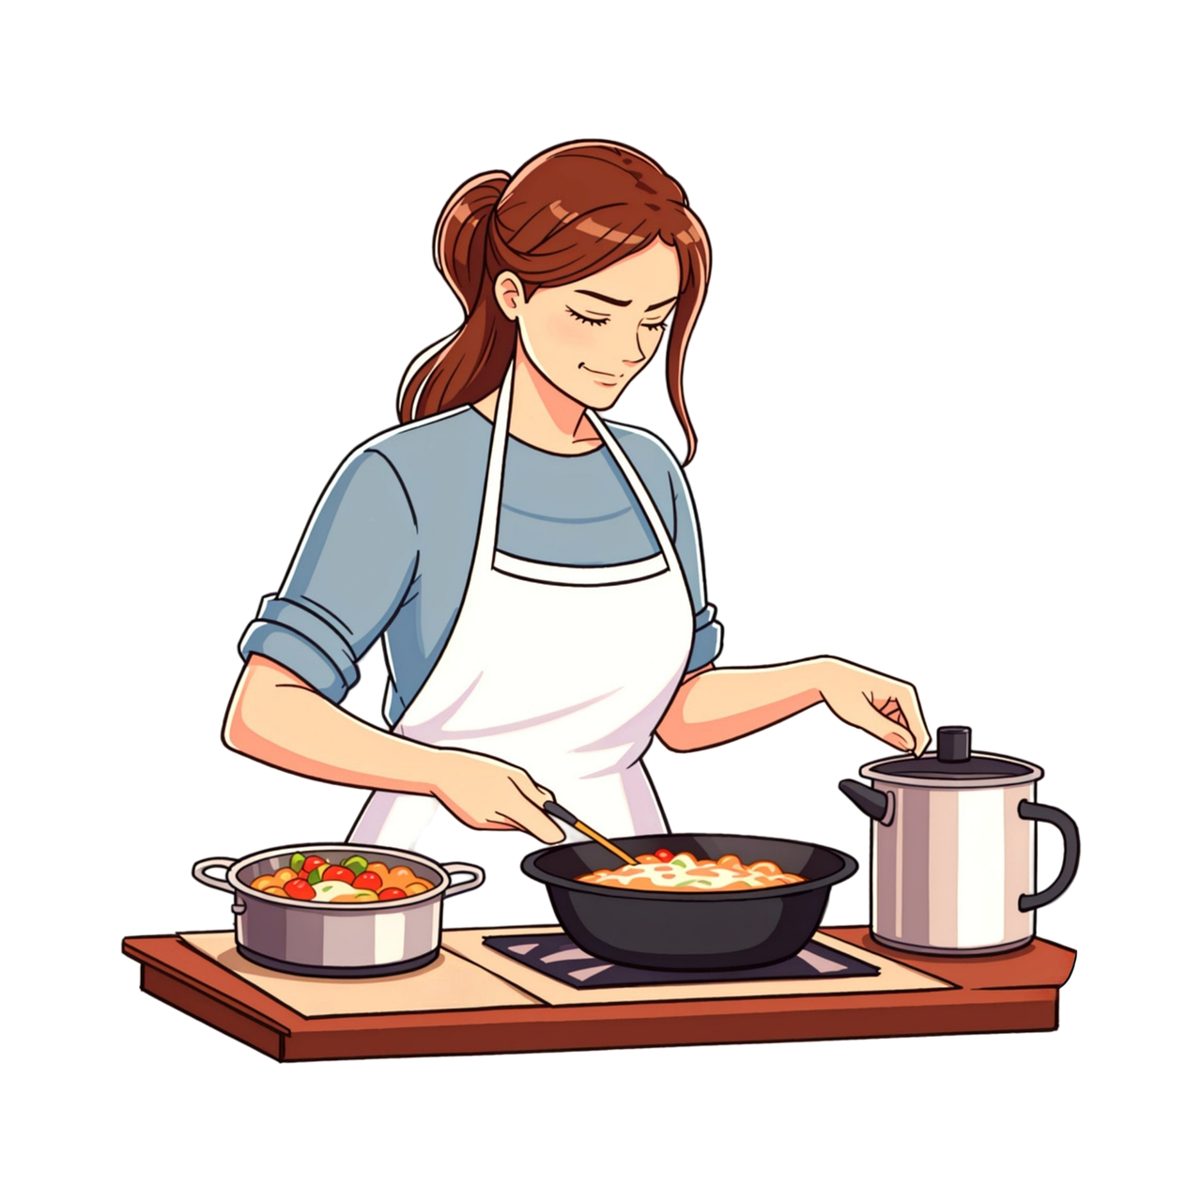
Conclusion
Reduces food waste by using leftover ingredients.
Saves time deciding what to cook.
Makes cooking easier with step-by-step instructions.
Offers personalized recipes for healthier eating.
Brings convenience and makes cooking enjoyable.
Reduces stress in meal planning and preparation

Slide 10
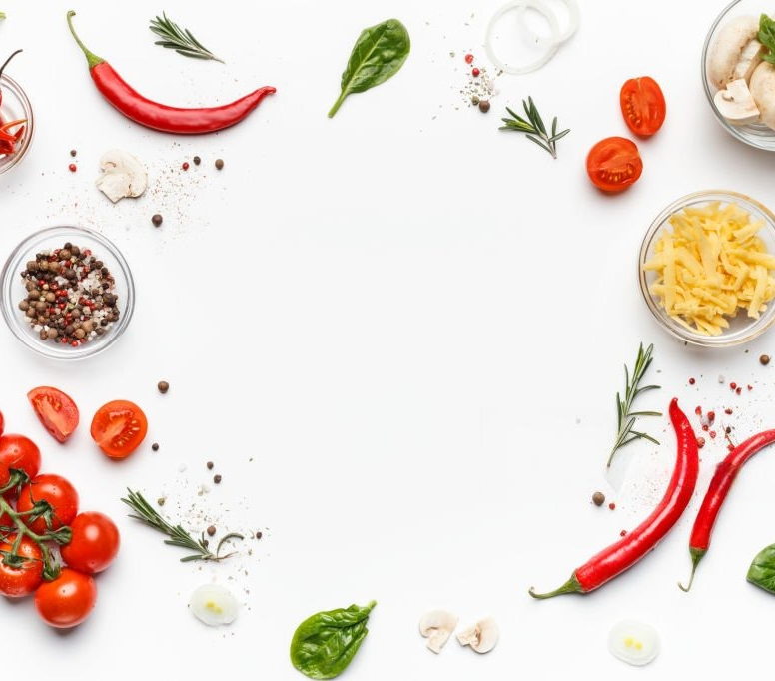
Thank you
“Transforming everyday ingredients into
Extraordinary meals with the power of AI”

